Slide 1
SORACOM Icon Set
v2.5
Please check the guidelines for use.
SORACOM Icon Set Usage Guidelines
https://soracom.jp/share/sis_guideline/

Slide 2
Cloud A
Cloud B
Telephone Exchange
Base Station
Internet
SIM
PC
LAPTOP
Smart Phone
Tablet
Feature Phone
Camera
Surveillance Camera
Drone
Smart Watch
Board
Dongle
Transmitter A
Transmitter B
Controller A
Controller B
IoT Device Group
Server A
Server B
Server C
Database
User A
User B
Security A
Security B

Slide 3
Security C
Security D
Link A
Link B
Code
Config A
Config B
Config C
Power
Watch
Alert
Send
Attention A
Attention B
Time
Day Time
Night Time
Auth Key
Authenticated
Authentication
Protect
Protect with Key
API
Protocol
Controllable
SDK
Big Data
Graph
Mail
Read

Slide 4
Reload
Expansion
Shrinking
Arrow A
Arrow B
Arrow C
Arrow D
(upload, download)
System Process A
(gateway)
System Process B
System Process C
System Process D
System Process E
Soracom Air
(Active)
Soracom Air
(Stop)
Soracom Air
(Inactive)
Soracom Air
(Low Speed)
Soracom Air
(High Speed)
Soracom Air
(Checked)
Soracom Air
(Fast)
Soracom Air
(Slow)
Soracom Air
(Standard)
Soracom Air
(Minimum)
Soracom Air
(Live)
Soracom Air
(Dead)
Soracom Air
(Unknown)
Soracom Air
(Free)
Communication Path
(Branch)
Communication Path
(Conversion)
Communication Path
(Consolidation)
SBR A

Slide 5
SBR B
Global
LoRa Base A
LoRa Base B
LoRa Device A
LoRa Device B
LoRa A
LoRa B
VPG
Gateway
Interconnection network
Safe
Danger
Connect A
Connect B
Connect C
Beer
Sigfox Device A
Sigfox Device B
Sigfox A
Sigfox B
Car
Taxi
Truck
Bus
Train
Motor Scooter
Motorcycle
Bicycle
Plane

Slide 6
Helicopter
Excavator
Crane
Bulldozer
Dump Truck
Tractor
Truck Snow Blower
Boat
Ship
Freighter
Balloon
Space Shuttle
UFO
Satellite
eSIM A
Air eSIM A
Air eSIM B
Soracom Funnel Adaptor
SPS Partner A
SPS Partner B
LTE Devices A
LTE Devices B
LTE A
LTE B
3G Devices A
3G Devices B
3G A
3G B
Microcomputer
Wio LTE

Slide 7
Wio 3G
Processor
Button
Buzzer
Indicator
Thermometer
Hygrometer
Sound wave
Acceleration
Gyroscope
Machine Learning Engine A
Machine Learning Model A
Machine Learning Engine B
Machine Learning Model B
Graph B
Graph C
Graph D
Graph E
Currency A
Currency B
Currency C
Graph F
Graph G
Arrow E
Arrow F
Router C
Switching hub B
Router A
Switching hub A
Router B

Slide 8
Excalibur
Slime
House
Store
Factory A
Factory B
Meter
Vending machine
Crossing
Handheld terminal
POS cash-register
Generator
PLC
Analog meter
7 segment
Robotic Arm
Robot
Conveyor
Signal
SIM(Suspended)
Map
Ethernet
LTE-M Devices A
LTE-M Devices B
LTE-M A
LTE-M B
Suspect
Edge AI Camera
VPG Type-C
VPG Type-D

Slide 9
VPG Type-E
VPG Type-F
Connector
GPS Multiunit Soracom Edition
5G Devices A
5G Devices B
5G A
5G B
Virtual SIM
Diagnostics
soratun
Soracom Cloud Camera Services
ATOM Cam 2
Battery
(Full)
Battery
(Half)
Battery
(Empty)
Still Image
(Outdoor)
Still Image
(Indoor)
Video
Console
Soracom CLI
Signature
VPG Type-G
iSIM A
iSIM B
iSIM C
VPG Type-F2
Administrator
Chat
Chat mode

Slide 10
Air
(Testing)
EV Charger
Ground station
(Satellite)
Refrigerator
SQL
Binary
Binary Parser
Metadata Service
Display

Slide 11
Soracom Platform A
Soracom Platform B
IoT SIM A
IoT SIM B
Soracom Beam
Soracom Canal
Soracom Direct
Soracom Endorse
Soracom Funnel
Soracom Door
Soracom Gate
IoT SIM for Global A
IoT SIM for Global B
Soracom Harvest
Soracom Inventory
Soracom Inventory client
Soracom Junction
Soracom Air
Soracom Krypton
Soracom Krypton key
Soracom Lagoon
Soracom Funk
Soracom Napter
Soracom Orbit
Soracom Peek
Soracom Arc
Soracom Relay
Soracom Flux
Soracom Query

Slide 12
Cloud A
Cloud B
Telephone Exchange
Base Station
Internet
SIM
PC
LAPTOP
Smart Phone
Tablet
Feature Phone
Camera
Surveillance Camera
Drone
Smart Watch
Board
Dongle
Transmitter A
Transmitter B
Controller A
Controller B
IoT Device Group
Server A
Server B
Server C
Database
User A
User B
Security A
Security B

Slide 13
Security C
Security D
Link A
Link B
Code
Config A
Config B
Config C
Power
Watch
Alert
Send
Attention A
Attention B
Time
Day Time
Night Time
Auth Key
Authenticated
Authentication
Protect
Protect with Key
API
Protocol
Controllable
SDK
Big Data
Graph
Mail
Read

Slide 14
Reload
Expansion
Shrinking
Arrow A
Arrow B
Arrow C
Arrow D
(upload, download)
System Process A
(gateway)
System Process B
System Process C
System Process D
System Process E
Soracom Air
(Active)
Soracom Air
(Stop)
Soracom Air
(Inactive)
Soracom Air
(Low Speed)
Soracom Air
(High Speed)
Soracom Air
(Checked)
Soracom Air
(Fast)
Soracom Air
(Slow)
Soracom Air
(Standard)
Soracom Air
(Minimum)
Soracom Air
(Live)
Soracom Air
(Dead)
Soracom Air
(Unknown)
Soracom Air
(Free)
Communication Path
(Branch)
Communication Path
(Conversion)
Communication Path
(Consolidation)
SBR A

Slide 15
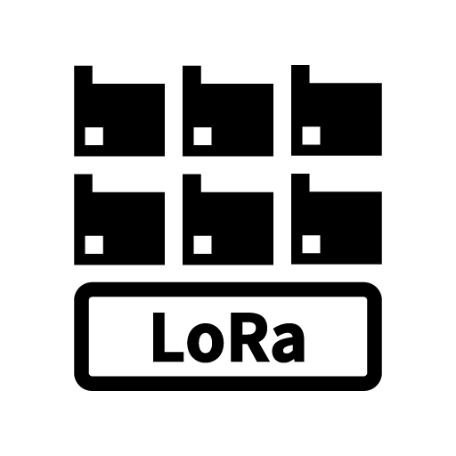
SBR B
Global
LoRa Base A
LoRa Base B
LoRa Device A
LoRa Device B
LoRa A
LoRa B
VPG
Gateway
Interconnection network
Safe
Danger
Connect A
Connect B
Connect C
Beer
Sigfox Device A
Sigfox Device B
Sigfox A
Sigfox B
Car
Taxi
Truck
Bus
Train
Motor Scooter
Motorcycle
Bicycle
Plane

Slide 16
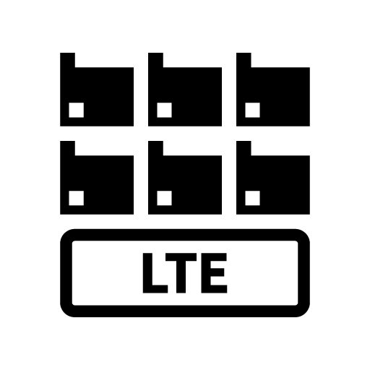
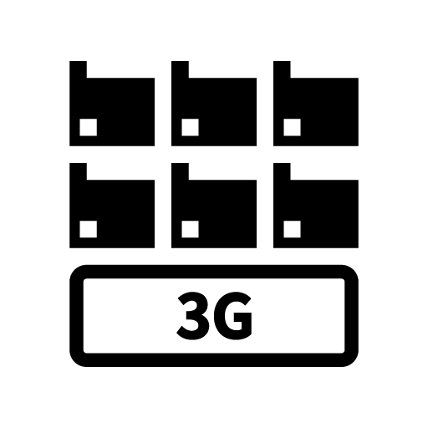
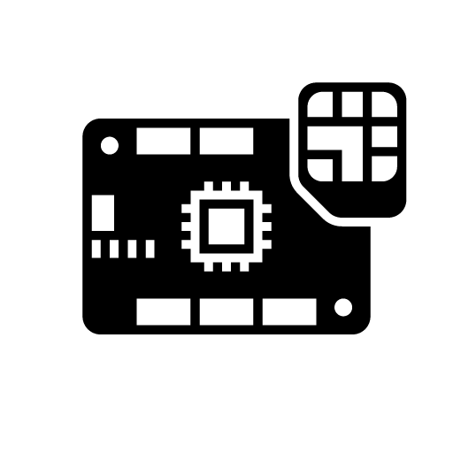
Helicopter
Excavator
Crane
Bulldozer
Dump Truck
Tractor
Truck Snow Blower
Boat
Ship
Freighter
Balloon
Space Shuttle
UFO
Satellite
eSIM A
Air eSIM A
Air eSIM B
Soracom Funnel Adaptor
SPS Partner A
SPS Partner B
LTE Devices A
LTE Devices B
LTE A
LTE B
3G Devices A
3G Devices B
3G A
3G B
Microcomputer
Wio LTE

Slide 17
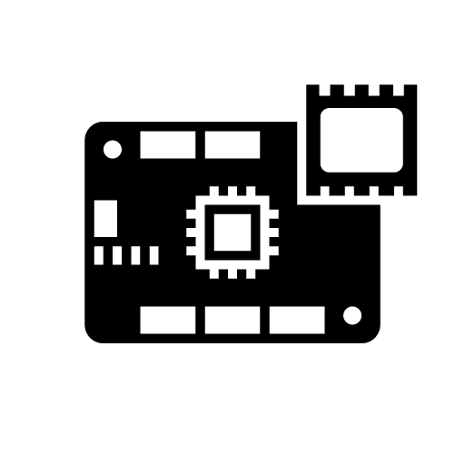
Wio 3G
Processor
Button
Buzzer
Indicator
Thermometer
Hygrometer
Sound wave
Acceleration
Gyroscope
Machine Learning Engine A
Machine Learning Model A
Machine Learning Engine B
Machine Learning Model B
Graph B
Graph C
Graph D
Graph E
Currency A
Currency B
Currency C
Graph F
Graph G
Arrow E
Arrow F
Router C
Switching hub B
Router A
Switching hub A
Router B

Slide 18
Excalibur
Slime
House
Store
Factory A
Factory B
Meter
Vending machine
Crossing
Handheld terminal
POS cash-register
Generator
PLC
Analog meter
7 segment
Robotic Arm
Robot
Conveyor
Signal
SIM(Suspended)
Map
Ethernet
LTE-M Devices A
LTE-M Devices B
LTE-M A
LTE-M B
Suspect
Edge AI Camera
VPG Type-C
VPG Type-D

Slide 19
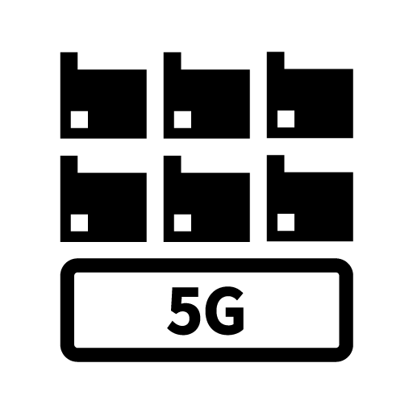
VPG Type-E
VPG Type-F
Connector
GPS Multiunit Soracom Edition
5G Devices A
5G Devices B
5G A
5G B
Virtual SIM
Diagnostics
soratun
Soracom Cloud Camera Services
ATOM Cam 2
Battery
(Full)
Battery
(Half)
Battery
(Empty)
Still Image
(Outdoor)
Still Image
(Indoor)
Video
Console
Soracom CLI
Signature
VPG Type-G
iSIM A
iSIM B
iSIM C
VPG Type-F2
Administrator
Chat
Chat mode

Slide 20
Air
(Testing)
EV Charger
Ground station
(Satellite)
Refrigerator
SQL
Binary
Binary Parser
Metadata Service
Display

Slide 21
Soracom Platform A
Soracom Platform B
IoT SIM A
IoT SIM B
Soracom Beam
Soracom Canal
Soracom Direct
Soracom Endorse
Soracom Funnel
Soracom Door
Soracom Gate
IoT SIM for Global A
IoT SIM for Global B
Soracom Harvest
Soracom Inventory
Soracom Inventory client
Soracom Junction
Soracom Air
Soracom Krypton
Soracom Krypton key
Soracom Lagoon
Soracom Funk
Soracom Napter
Soracom Orbit
Soracom Peek
Soracom Arc
Soracom Relay
Soracom Flux
Soracom Query

Slide 22
Cloud A
Cloud B
Telephone Exchange
Base Station
Internet
SIM
PC
LAPTOP
Smart Phone
Tablet
Feature Phone
Camera
Surveillance Camera
Drone
Smart Watch
Board
Dongle
Transmitter A
Transmitter B
Controller A
Controller B
IoT Device Group
Server A
Server B
Server C
Database
User A
User B
Security A
Security B

Slide 23
Security C
Security D
Link A
Link B
Code
Config A
Config B
Config C
Power
Watch
Alert
Send
Attention A
Attention B
Time
Day Time
Night Time
Auth Key
Authenticated
Authentication
Protect
Protect with Key
API
Protocol
Controllable
SDK
Big Data
Graph
Mail
Read

Slide 24
Reload
Expansion
Shrinking
Arrow A
Arrow B
Arrow C
Arrow D
(upload, download)
System Process A
(gateway)
System Process B
System Process C
System Process D
System Process E
Soracom Air
(Active)
Soracom Air
(Stop)
Soracom Air
(Inactive)
Soracom Air
(Low Speed)
Soracom Air
(High Speed)
Soracom Air
(Checked)
Soracom Air
(Fast)
Soracom Air
(Slow)
Soracom Air
(Standard)
Soracom Air
(Minimum)
Soracom Air
(Live)
Soracom Air
(Dead)
Soracom Air
(Unknown)
Soracom Air
(Free)
Communication Path
(Branch)
Communication Path
(Conversion)
Communication Path
(Consolidation)
SBR A

Slide 25
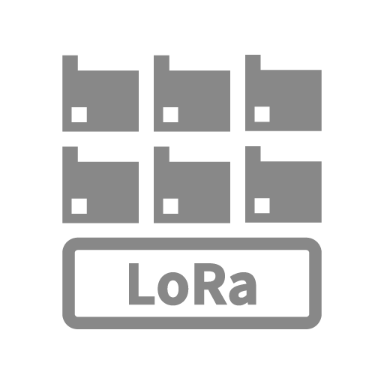
SBR B
Global
LoRa Base A
LoRa Base B
LoRa Device A
LoRa Device B
LoRa A
LoRa B
VPG
Gateway
Interconnection network
Safe
Danger
Connect A
Connect B
Connect C
Beer
Sigfox Device A
Sigfox Device B
Sigfox A
Sigfox B
Car
Taxi
Truck
Bus
Train
Motor Scooter
Motorcycle
Bicycle
Plane

Slide 26
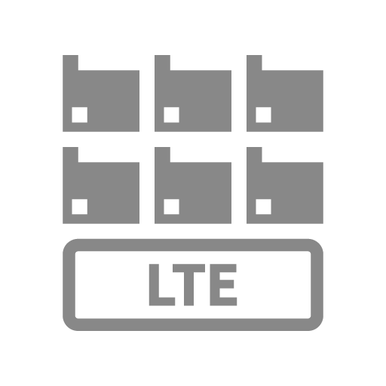
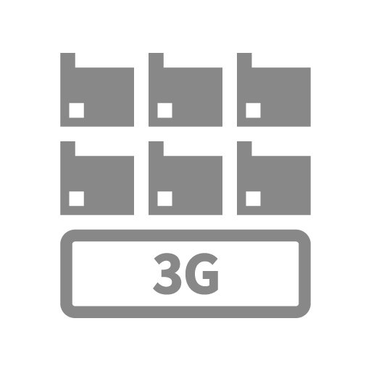
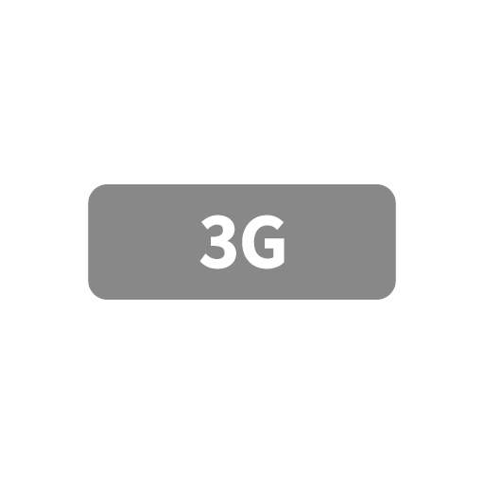
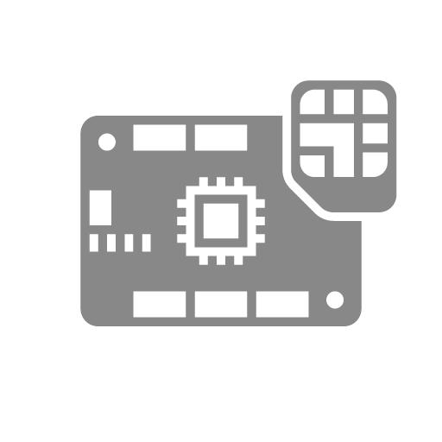
Helicopter
Excavator
Crane
Bulldozer
Dump Truck
Tractor
Truck Snow Blower
Boat
Ship
Freighter
Balloon
Space Shuttle
UFO
Satellite
eSIM A
Air eSIM A
Air eSIM B
Soracom Funnel Adaptor
SPS Partner A
SPS Partner B
LTE Devices A
LTE Devices B
LTE A
LTE B
3G Devices A
3G Devices B
3G A
3G B
Microcomputer
Wio LTE

Slide 27
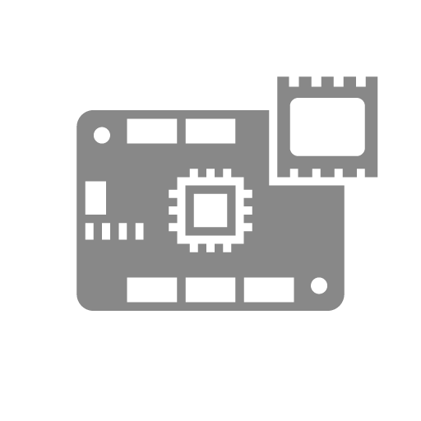
Wio 3G
Processor
Button
Buzzer
Indicator
Thermometer
Hygrometer
Sound wave
Acceleration
Gyroscope
Machine Learning Engine A
Machine Learning Model A
Machine Learning Engine B
Machine Learning Model B
Graph B
Graph C
Graph D
Graph E
Currency A
Currency B
Currency C
Graph F
Graph G
Arrow E
Arrow F
Router C
Switching hub B
Router A
Switching hub A
Router B

Slide 28
Excalibur
Slime
House
Store
Factory A
Factory B
Meter
Vending machine
Crossing
Handheld terminal
POS cash-register
Generator
PLC
Analog meter
7 segment
Robotic Arm
Robot
Conveyor
Signal
SIM(Suspended)
Map
Ethernet
LTE-M Devices A
LTE-M Devices B
LTE-M A
LTE-M B
Suspect
Edge AI Camera
VPG Type-C
VPG Type-D

Slide 29
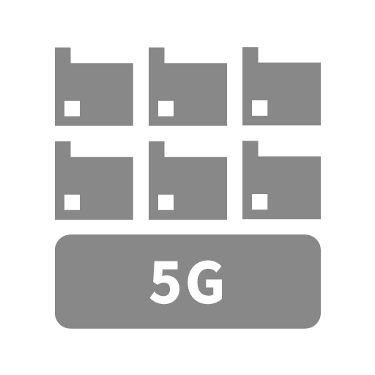
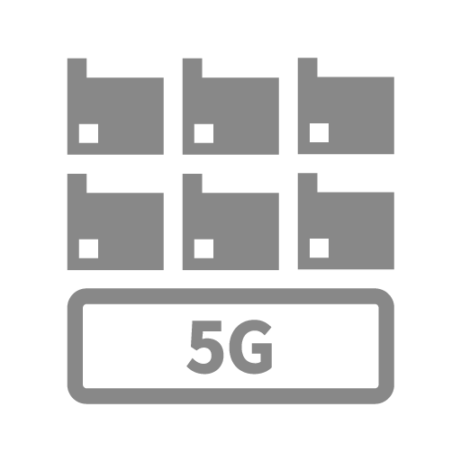
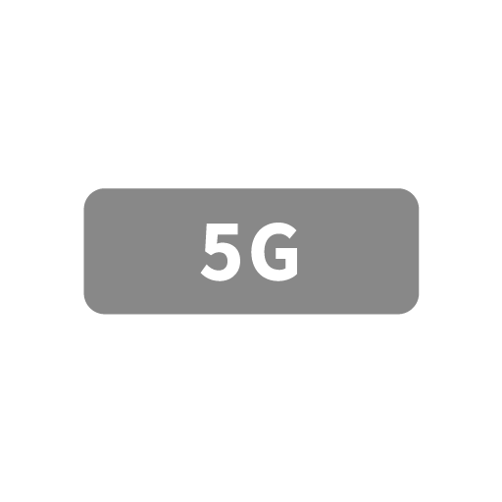
VPG Type-E
VPG Type-F
Connector
GPS Multiunit Soracom Edition
5G Devices A
5G Devices B
5G A
5G B
Virtual SIM
Diagnostics
soratun
Soracom Cloud Camera Services
ATOM Cam 2
Battery
(Full)
Battery
(Half)
Battery
(Empty)
Still Image
(Outdoor)
Still Image
(Indoor)
Video
Console
Soracom CLI
Signature
VPG Type-G
iSIM A
iSIM B
iSIM C
VPG Type-F2
Administrator
Chat
Chat mode

Slide 30
Air
(Testing)
EV Charger
Ground station
(Satellite)
Refrigerator
SQL
Binary
Binary Parser
Metadata Service
Display

Slide 31
Soracom Platform A
Soracom Platform B
IoT SIM A
IoT SIM B
Soracom Beam
Soracom Canal
Soracom Direct
Soracom Endorse
Soracom Funnel
Soracom Door
Soracom Gate
IoT SIM for Global A
IoT SIM for Global B
Soracom Harvest
Soracom Inventory
Soracom Inventory client
Soracom Junction
Soracom Air
Soracom Krypton
Soracom Krypton key
Soracom Lagoon
Soracom Funk
Soracom Napter
Soracom Orbit
Soracom Peek
Soracom Arc
Soracom Relay
Soracom Flux
Soracom Query

Slide 32
Cloud A
Cloud B
Telephone Exchange
Base Station
Internet
SIM
PC
LAPTOP
Smart Phone
Tablet
Feature Phone
Camera
Surveillance Camera
Drone
Smart Watch
Board
Dongle
Transmitter A
Transmitter B
Controller A
Controller B
IoT Device Group
Server A
Server B
Server C
Database
User A
User B
Security A
Security B

Slide 33
Security C
Security D
Link A
Link B
Code
Config A
Config B
Config C
Power
Watch
Alert
Send
Attention A
Attention B
Time
Day Time
Night Time
Auth Key
Authenticated
Authentication
Protect
Protect with Key
API
Protocol
Controllable
SDK
Big Data
Graph
Mail
Read

Slide 34
Reload
Expansion
Shrinking
Arrow A
Arrow B
Arrow C
Arrow D
(upload, download)
System Process A
(gateway)
System Process B
System Process C
System Process D
System Process E
Soracom Air
(Active)
Soracom Air
(Stop)
Soracom Air
(Inactive)
Soracom Air
(Low Speed)
Soracom Air
(High Speed)
Soracom Air
(Checked)
Soracom Air
(Fast)
Soracom Air
(Slow)
Soracom Air
(Standard)
Soracom Air
(Minimum)
Soracom Air
(Live)
Soracom Air
(Dead)
Soracom Air
(Unknown)
Soracom Air
(Free)
Communication Path
(Branch)
Communication Path
(Conversion)
Communication Path
(Consolidation)
SBR A

Slide 35
SBR B
Global
LoRa Base A
LoRa Base B
LoRa Device A
LoRa Device B
LoRa A
LoRa B
VPG
Gateway
Interconnection network
Safe
Danger
Connect A
Connect B
Connect C
Beer
Sigfox Device A
Sigfox Device B
Sigfox A
Sigfox B
Car
Taxi
Truck
Bus
Train
Motor Scooter
Motorcycle
Bicycle
Plane

Slide 36
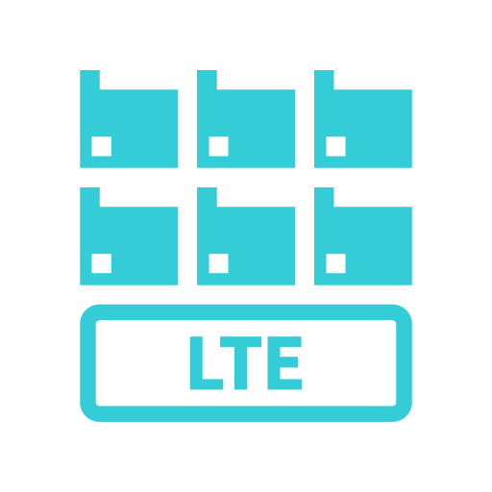
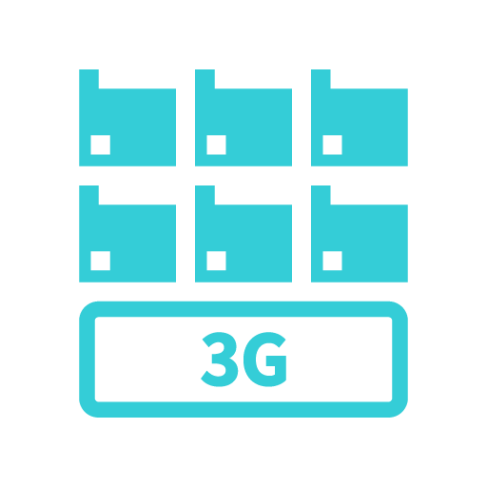
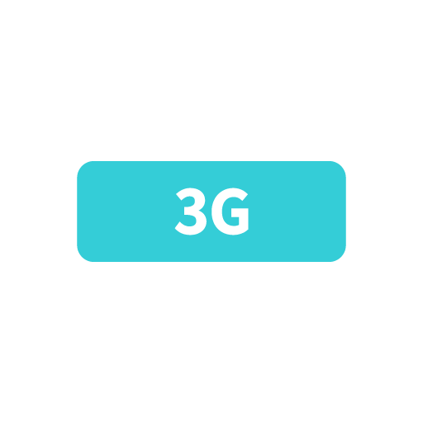
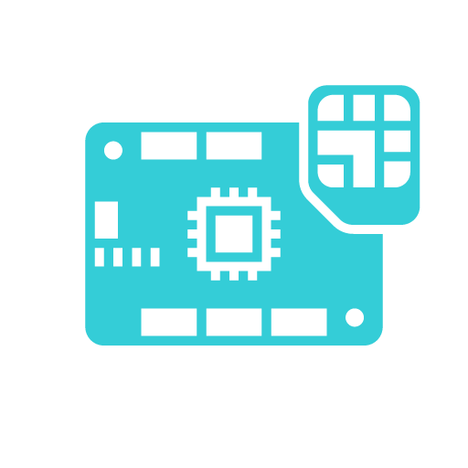
Helicopter
Excavator
Crane
Bulldozer
Dump Truck
Tractor
Truck Snow Blower
Boat
Ship
Freighter
Balloon
Space Shuttle
UFO
Satellite
eSIM A
Air eSIM A
Air eSIM B
Soracom Funnel Adaptor
SPS Partner A
SPS Partner B
LTE Devices A
LTE Devices B
LTE A
LTE B
3G Devices A
3G Devices B
3G A
3G B
Microcomputer
Wio LTE

Slide 37
Wio 3G
Processor
Button
Buzzer
Indicator
Thermometer
Hygrometer
Sound wave
Acceleration
Gyroscope
Machine Learning Engine A
Machine Learning Model A
Machine Learning Engine B
Machine Learning Model B
Graph B
Graph C
Graph D
Graph E
Currency A
Currency B
Currency C
Graph F
Graph G
Arrow E
Arrow F
Router C
Switching hub B
Router A
Switching hub A
Router B

Slide 38
Excalibur
Slime
House
Store
Factory A
Factory B
Meter
Vending machine
Crossing
Handheld terminal
POS cash-register
Generator
PLC
Analog meter
7 segment
Robotic Arm
Robot
Conveyor
Signal
SIM(Suspended)
Map
Ethernet
LTE-M Devices A
LTE-M Devices B
LTE-M A
LTE-M B
Suspect
Edge AI Camera
VPG Type-C
VPG Type-D

Slide 39
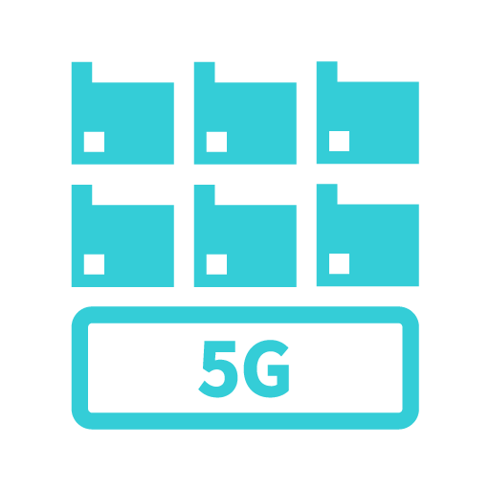
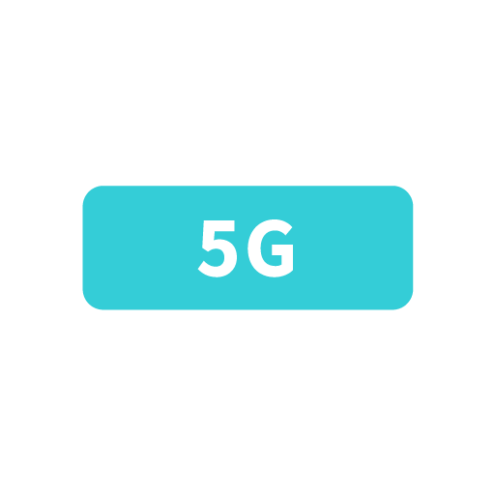
VPG Type-E
VPG Type-F
Connector
GPS Multiunit Soracom Edition
5G Devices A
5G Devices B
5G A
5G B
Virtual SIM
Diagnostics
soratun
Soracom Cloud Camera Services
ATOM Cam 2
Battery
(Full)
Battery
(Half)
Battery
(Empty)
Still Image
(Outdoor)
Still Image
(Indoor)
Video
Console
Soracom CLI
Signature
VPG Type-G
iSIM A
iSIM B
iSIM C
VPG Type-F2
Administrator
Chat
Chat mode

Slide 40
Air
(Testing)
EV Charger
Ground station
(Satellite)
Refrigerator
SQL
Binary
Binary Parser
Metadata Service
Display

Slide 41
Soracom Platform A
Soracom Platform B
IoT SIM A
IoT SIM B
Soracom Beam
Soracom Canal
Soracom Direct
Soracom Endorse
Soracom Funnel
Soracom Door
Soracom Gate
IoT SIM for Global A
IoT SIM for Global B
Soracom Harvest
Soracom Inventory
Soracom Inventory client
Soracom Junction
Soracom Air
Soracom Krypton
Soracom Krypton key
Soracom Lagoon
Soracom Funk
Soracom Napter
Soracom Orbit
Soracom Peek
Soracom Arc
Soracom Relay
Soracom Flux
Soracom Query

