Slide 1


















SORACOM Icon Set
v2.6
Please check the guidelines for use.
SORACOM Icon Set Usage Guidelines
https://soracom.jp/share/sis_guideline/

Slide 2






























Cloud A
Cloud B
Telephone Exchange
Base Station
Internet
SIM
PC
LAPTOP
Smart Phone
Tablet
Feature Phone
Camera
Surveillance Camera
Drone
Smart Watch
Board
Dongle
Transmitter A
Transmitter B
Controller A
Controller B
IoT Device Group
Server A
Server B
Server C
Database
User A
User B
Security A
Security B

Slide 3






























Security C
Security D
Link A
Link B
Code
Config A
Config B
Config C
Power
Watch
Alert
Send
Attention A
Attention B
Time
Day Time
Night Time
Auth Key
Authenticated
Authentication
Protect
Protect with Key
API
Protocol
Controllable
SDK
Big Data
Graph
Mail
Read

Slide 4






























Reload
Expansion
Shrinking
Arrow A
Arrow B
Arrow C
Arrow D
(upload, download)
System Process A
(gateway)
System Process B
System Process C
System Process D
System Process E
Soracom Air
(Active)
Soracom Air
(Stop)
Soracom Air
(Inactive)
Soracom Air
(Low Speed)
Soracom Air
(High Speed)
Soracom Air
(Checked)
Soracom Air
(Fast)
Soracom Air
(Slow)
Soracom Air
(Standard)
Soracom Air
(Minimum)
Soracom Air
(Live)
Soracom Air
(Dead)
Soracom Air
(Unknown)
Soracom Air
(Free)
Communication Path
(Branch)
Communication Path
(Conversion)
Communication Path
(Consolidation)
SBR A

Slide 5






























SBR B
Global
LoRa Base A
LoRa Base B
LoRa Device A
LoRa Device B
LoRa A
LoRa B
VPG
Gateway
Interconnection network
Safe
Danger
Connect A
Connect B
Connect C
Beer
Sigfox Device A
Sigfox Device B
Sigfox A
Sigfox B
Car
Taxi
Truck
Bus
Train
Motor Scooter
Motorcycle
Bicycle
Plane

Slide 6






























Helicopter
Excavator
Crane
Bulldozer
Dump Truck
Tractor
Truck Snow Blower
Boat
Ship
Freighter
Balloon
Space Shuttle
UFO
Satellite
eSIM A
Air eSIM A
Air eSIM B
Soracom Funnel Adaptor
SPS Partner A
SPS Partner B
LTE Devices A
LTE Devices B
LTE A
LTE B
3G Devices A
3G Devices B
3G A
3G B
Microcomputer
Wio LTE

Slide 7






























Wio 3G
Processor
Button
Buzzer
Indicator
Thermometer
Hygrometer
Sound wave
Acceleration
Gyroscope
Machine Learning Engine A
Machine Learning Model A
Machine Learning Engine B
Machine Learning Model B
Graph B
Graph C
Graph D
Graph E
Currency A
Currency B
Currency C
Graph F
Graph G
Arrow E
Arrow F
Router C
Switching hub B
Router A
Switching hub A
Router B

Slide 8






























Excalibur
Slime
House
Store
Factory A
Factory B
Meter
Vending machine
Crossing
Handheld terminal
POS cash-register
Generator
PLC
Analog meter
7 segment
Robotic Arm
Robot
Conveyor
Signal
SIM(Suspended)
Map
Ethernet
LTE-M Devices A
LTE-M Devices B
LTE-M A
LTE-M B
Suspect
Edge AI Camera
VPG Type-C
VPG Type-D

Slide 9






























VPG Type-E
VPG Type-F
Connector
GPS Multiunit Soracom Edition
5G Devices A
5G Devices B
5G A
5G B
Virtual SIM
Diagnostics
soratun
Soracom Cloud Camera Services
ATOM Cam 2
Battery
(Full)
Battery
(Half)
Battery
(Empty)
Still Image
(Outdoor)
Still Image
(Indoor)
Video
Console
Soracom CLI
Signature
VPG Type-G
iSIM A
iSIM B
iSIM C
VPG Type-F2
Administrator
Chat
Chat mode

Slide 10











Air
(Testing)
EV Charger
Ground station
(Satellite)
Refrigerator
SQL
Binary
Binary Parser
Metadata Service
Display
SoraCam Pro
Connectivity Hypervisor capable IoT SIM

Slide 11






























Soracom Platform A
Soracom Platform B
IoT SIM A
IoT SIM B
Soracom Beam
Soracom Canal
Soracom Direct
Soracom Endorse
Soracom Funnel
Soracom Door
Soracom Gate
IoT SIM for Global A
IoT SIM for Global B
Soracom Harvest
Soracom Inventory
Soracom Inventory client
Soracom Junction
Soracom Air
Soracom Krypton
Soracom Krypton key
Soracom Lagoon
Soracom Funk
Soracom Napter
Soracom Orbit
Soracom Peek
Soracom Arc
Soracom Relay
Soracom Flux
Soracom Query
Soracom Agent

Slide 12






























Cloud A
Cloud B
Telephone Exchange
Base Station
Internet
SIM
PC
LAPTOP
Smart Phone
Tablet
Feature Phone
Camera
Surveillance Camera
Drone
Smart Watch
Board
Dongle
Transmitter A
Transmitter B
Controller A
Controller B
IoT Device Group
Server A
Server B
Server C
Database
User A
User B
Security A
Security B

Slide 13






























Security C
Security D
Link A
Link B
Code
Config A
Config B
Config C
Power
Watch
Alert
Send
Attention A
Attention B
Time
Day Time
Night Time
Auth Key
Authenticated
Authentication
Protect
Protect with Key
API
Protocol
Controllable
SDK
Big Data
Graph
Mail
Read

Slide 14






























Reload
Expansion
Shrinking
Arrow A
Arrow B
Arrow C
Arrow D
(upload, download)
System Process A
(gateway)
System Process B
System Process C
System Process D
System Process E
Soracom Air
(Active)
Soracom Air
(Stop)
Soracom Air
(Inactive)
Soracom Air
(Low Speed)
Soracom Air
(High Speed)
Soracom Air
(Checked)
Soracom Air
(Fast)
Soracom Air
(Slow)
Soracom Air
(Standard)
Soracom Air
(Minimum)
Soracom Air
(Live)
Soracom Air
(Dead)
Soracom Air
(Unknown)
Soracom Air
(Free)
Communication Path
(Branch)
Communication Path
(Conversion)
Communication Path
(Consolidation)
SBR A

Slide 15





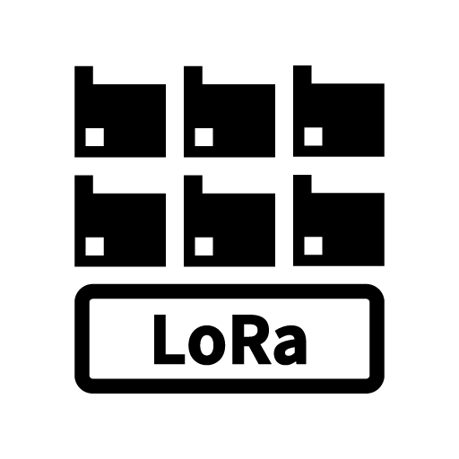
























SBR B
Global
LoRa Base A
LoRa Base B
LoRa Device A
LoRa Device B
LoRa A
LoRa B
VPG
Gateway
Interconnection network
Safe
Danger
Connect A
Connect B
Connect C
Beer
Sigfox Device A
Sigfox Device B
Sigfox A
Sigfox B
Car
Taxi
Truck
Bus
Train
Motor Scooter
Motorcycle
Bicycle
Plane

Slide 16





















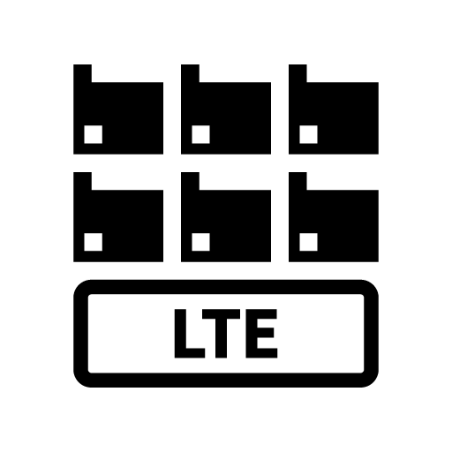



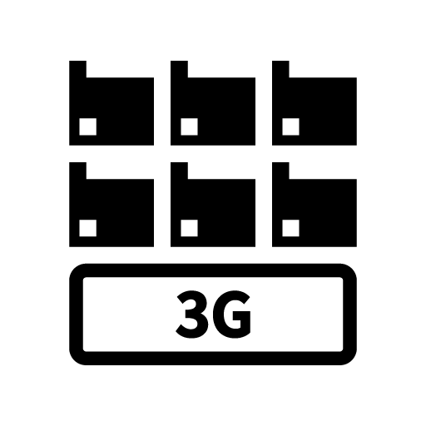



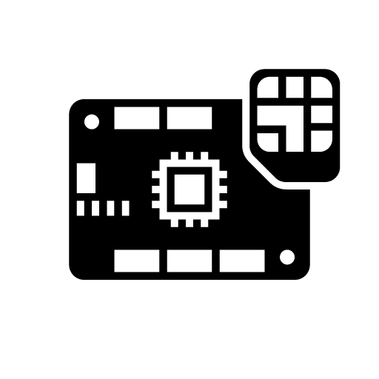
Helicopter
Excavator
Crane
Bulldozer
Dump Truck
Tractor
Truck Snow Blower
Boat
Ship
Freighter
Balloon
Space Shuttle
UFO
Satellite
eSIM A
Air eSIM A
Air eSIM B
Soracom Funnel Adaptor
SPS Partner A
SPS Partner B
LTE Devices A
LTE Devices B
LTE A
LTE B
3G Devices A
3G Devices B
3G A
3G B
Microcomputer
Wio LTE

Slide 17
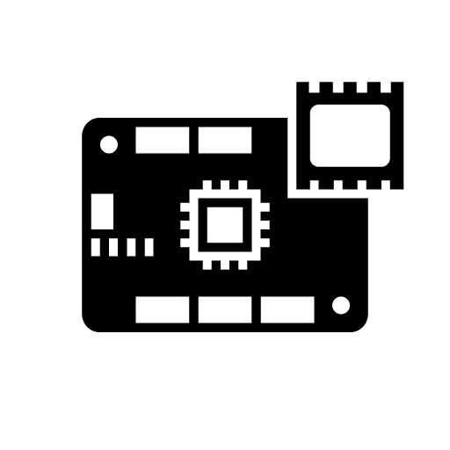





























Wio 3G
Processor
Button
Buzzer
Indicator
Thermometer
Hygrometer
Sound wave
Acceleration
Gyroscope
Machine Learning Engine A
Machine Learning Model A
Machine Learning Engine B
Machine Learning Model B
Graph B
Graph C
Graph D
Graph E
Currency A
Currency B
Currency C
Graph F
Graph G
Arrow E
Arrow F
Router C
Switching hub B
Router A
Switching hub A
Router B

Slide 18






























Excalibur
Slime
House
Store
Factory A
Factory B
Meter
Vending machine
Crossing
Handheld terminal
POS cash-register
Generator
PLC
Analog meter
7 segment
Robotic Arm
Robot
Conveyor
Signal
SIM(Suspended)
Map
Ethernet
LTE-M Devices A
LTE-M Devices B
LTE-M A
LTE-M B
Suspect
Edge AI Camera
VPG Type-C
VPG Type-D

Slide 19





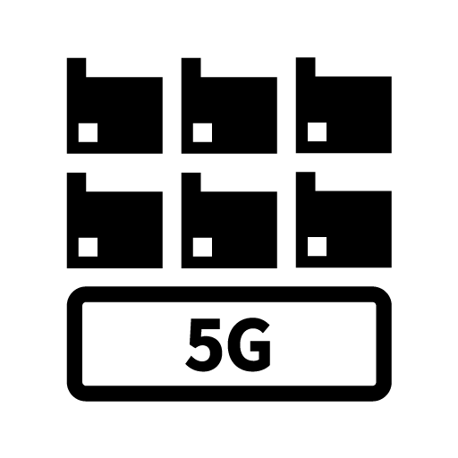
























VPG Type-E
VPG Type-F
Connector
GPS Multiunit Soracom Edition
5G Devices A
5G Devices B
5G A
5G B
Virtual SIM
Diagnostics
soratun
Soracom Cloud Camera Services
ATOM Cam 2
Battery
(Full)
Battery
(Half)
Battery
(Empty)
Still Image
(Outdoor)
Still Image
(Indoor)
Video
Console
Soracom CLI
Signature
VPG Type-G
iSIM A
iSIM B
iSIM C
VPG Type-F2
Administrator
Chat
Chat mode

Slide 20











Air
(Testing)
EV Charger
Ground station
(Satellite)
Refrigerator
SQL
Binary
Binary Parser
Metadata Service
Display
SoraCam Pro
Connectivity Hypervisor capable IoT SIM

Slide 21






























Soracom Platform A
Soracom Platform B
IoT SIM A
IoT SIM B
Soracom Beam
Soracom Canal
Soracom Direct
Soracom Endorse
Soracom Funnel
Soracom Door
Soracom Gate
IoT SIM for Global A
IoT SIM for Global B
Soracom Harvest
Soracom Inventory
Soracom Inventory client
Soracom Junction
Soracom Air
Soracom Krypton
Soracom Krypton key
Soracom Lagoon
Soracom Funk
Soracom Napter
Soracom Orbit
Soracom Peek
Soracom Arc
Soracom Relay
Soracom Flux
Soracom Query
Soracom Agent

Slide 22






























Cloud A
Cloud B
Telephone Exchange
Base Station
Internet
SIM
PC
LAPTOP
Smart Phone
Tablet
Feature Phone
Camera
Surveillance Camera
Drone
Smart Watch
Board
Dongle
Transmitter A
Transmitter B
Controller A
Controller B
IoT Device Group
Server A
Server B
Server C
Database
User A
User B
Security A
Security B

Slide 23






























Security C
Security D
Link A
Link B
Code
Config A
Config B
Config C
Power
Watch
Alert
Send
Attention A
Attention B
Time
Day Time
Night Time
Auth Key
Authenticated
Authentication
Protect
Protect with Key
API
Protocol
Controllable
SDK
Big Data
Graph
Mail
Read

Slide 24






























Reload
Expansion
Shrinking
Arrow A
Arrow B
Arrow C
Arrow D
(upload, download)
System Process A
(gateway)
System Process B
System Process C
System Process D
System Process E
Soracom Air
(Active)
Soracom Air
(Stop)
Soracom Air
(Inactive)
Soracom Air
(Low Speed)
Soracom Air
(High Speed)
Soracom Air
(Checked)
Soracom Air
(Fast)
Soracom Air
(Slow)
Soracom Air
(Standard)
Soracom Air
(Minimum)
Soracom Air
(Live)
Soracom Air
(Dead)
Soracom Air
(Unknown)
Soracom Air
(Free)
Communication Path
(Branch)
Communication Path
(Conversion)
Communication Path
(Consolidation)
SBR A

Slide 25





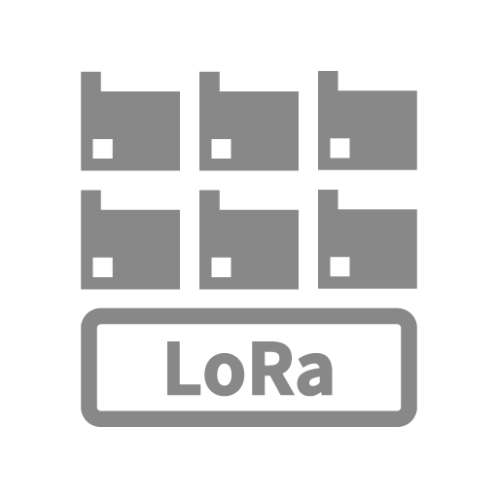
























SBR B
Global
LoRa Base A
LoRa Base B
LoRa Device A
LoRa Device B
LoRa A
LoRa B
VPG
Gateway
Interconnection network
Safe
Danger
Connect A
Connect B
Connect C
Beer
Sigfox Device A
Sigfox Device B
Sigfox A
Sigfox B
Car
Taxi
Truck
Bus
Train
Motor Scooter
Motorcycle
Bicycle
Plane

Slide 26





















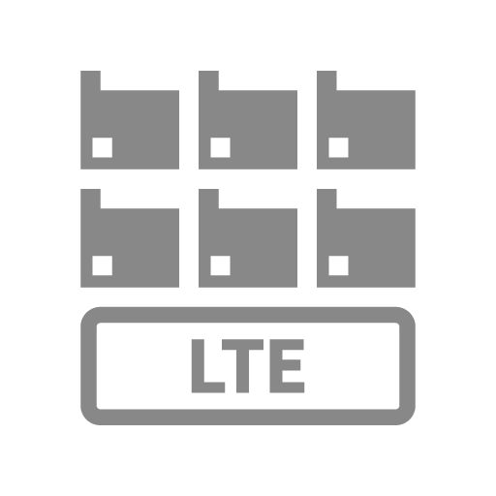




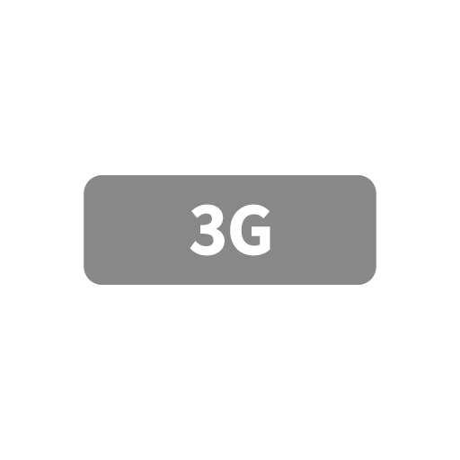


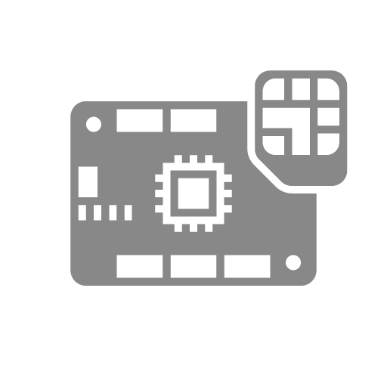
Helicopter
Excavator
Crane
Bulldozer
Dump Truck
Tractor
Truck Snow Blower
Boat
Ship
Freighter
Balloon
Space Shuttle
UFO
Satellite
eSIM A
Air eSIM A
Air eSIM B
Soracom Funnel Adaptor
SPS Partner A
SPS Partner B
LTE Devices A
LTE Devices B
LTE A
LTE B
3G Devices A
3G Devices B
3G A
3G B
Microcomputer
Wio LTE

Slide 27
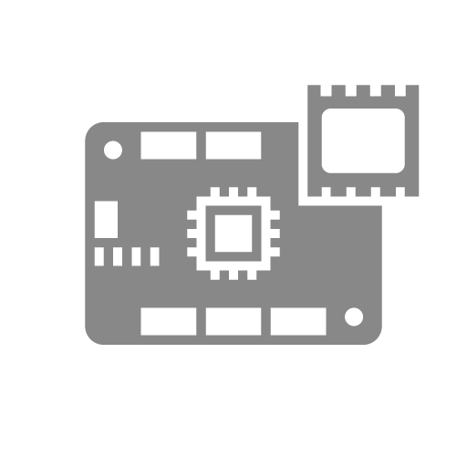





























Wio 3G
Processor
Button
Buzzer
Indicator
Thermometer
Hygrometer
Sound wave
Acceleration
Gyroscope
Machine Learning Engine A
Machine Learning Model A
Machine Learning Engine B
Machine Learning Model B
Graph B
Graph C
Graph D
Graph E
Currency A
Currency B
Currency C
Graph F
Graph G
Arrow E
Arrow F
Router C
Switching hub B
Router A
Switching hub A
Router B

Slide 28






























Excalibur
Slime
House
Store
Factory A
Factory B
Meter
Vending machine
Crossing
Handheld terminal
POS cash-register
Generator
PLC
Analog meter
7 segment
Robotic Arm
Robot
Conveyor
Signal
SIM(Suspended)
Map
Ethernet
LTE-M Devices A
LTE-M Devices B
LTE-M A
LTE-M B
Suspect
Edge AI Camera
VPG Type-C
VPG Type-D

Slide 29




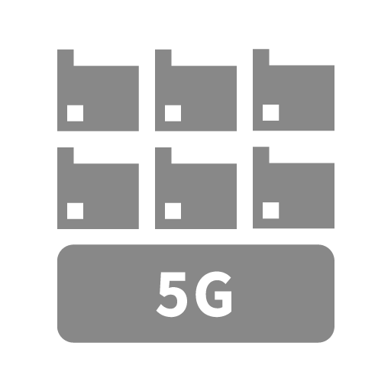
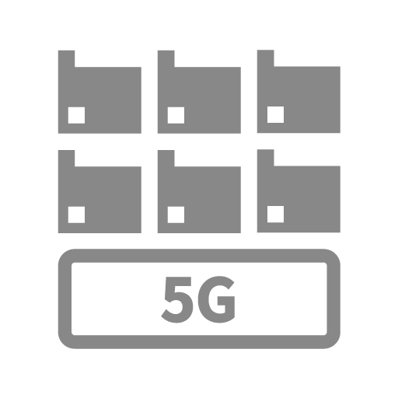
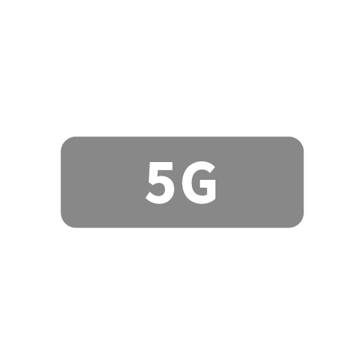























VPG Type-E
VPG Type-F
Connector
GPS Multiunit Soracom Edition
5G Devices A
5G Devices B
5G A
5G B
Virtual SIM
Diagnostics
soratun
Soracom Cloud Camera Services
ATOM Cam 2
Battery
(Full)
Battery
(Half)
Battery
(Empty)
Still Image
(Outdoor)
Still Image
(Indoor)
Video
Console
Soracom CLI
Signature
VPG Type-G
iSIM A
iSIM B
iSIM C
VPG Type-F2
Administrator
Chat
Chat mode

Slide 30











Air
(Testing)
EV Charger
Ground station
(Satellite)
Refrigerator
SQL
Binary
Binary Parser
Metadata Service
Display
SoraCam Pro
Connectivity Hypervisor capable IoT SIM

Slide 31






























Soracom Platform A
Soracom Platform B
IoT SIM A
IoT SIM B
Soracom Beam
Soracom Canal
Soracom Direct
Soracom Endorse
Soracom Funnel
Soracom Door
Soracom Gate
IoT SIM for Global A
IoT SIM for Global B
Soracom Harvest
Soracom Inventory
Soracom Inventory client
Soracom Junction
Soracom Air
Soracom Krypton
Soracom Krypton key
Soracom Lagoon
Soracom Funk
Soracom Napter
Soracom Orbit
Soracom Peek
Soracom Arc
Soracom Relay
Soracom Flux
Soracom Query
Soracom Agent

Slide 32






























Cloud A
Cloud B
Telephone Exchange
Base Station
Internet
SIM
PC
LAPTOP
Smart Phone
Tablet
Feature Phone
Camera
Surveillance Camera
Drone
Smart Watch
Board
Dongle
Transmitter A
Transmitter B
Controller A
Controller B
IoT Device Group
Server A
Server B
Server C
Database
User A
User B
Security A
Security B

Slide 33






























Security C
Security D
Link A
Link B
Code
Config A
Config B
Config C
Power
Watch
Alert
Send
Attention A
Attention B
Time
Day Time
Night Time
Auth Key
Authenticated
Authentication
Protect
Protect with Key
API
Protocol
Controllable
SDK
Big Data
Graph
Mail
Read

Slide 34






























Reload
Expansion
Shrinking
Arrow A
Arrow B
Arrow C
Arrow D
(upload, download)
System Process A
(gateway)
System Process B
System Process C
System Process D
System Process E
Soracom Air
(Active)
Soracom Air
(Stop)
Soracom Air
(Inactive)
Soracom Air
(Low Speed)
Soracom Air
(High Speed)
Soracom Air
(Checked)
Soracom Air
(Fast)
Soracom Air
(Slow)
Soracom Air
(Standard)
Soracom Air
(Minimum)
Soracom Air
(Live)
Soracom Air
(Dead)
Soracom Air
(Unknown)
Soracom Air
(Free)
Communication Path
(Branch)
Communication Path
(Conversion)
Communication Path
(Consolidation)
SBR A

Slide 35






























SBR B
Global
LoRa Base A
LoRa Base B
LoRa Device A
LoRa Device B
LoRa A
LoRa B
VPG
Gateway
Interconnection network
Safe
Danger
Connect A
Connect B
Connect C
Beer
Sigfox Device A
Sigfox Device B
Sigfox A
Sigfox B
Car
Taxi
Truck
Bus
Train
Motor Scooter
Motorcycle
Bicycle
Plane

Slide 36

















Helicopter
Excavator
Crane
Bulldozer
Dump Truck
Tractor
Truck Snow Blower
Boat
Ship
Freighter
Balloon
Space Shuttle
UFO
Satellite
eSIM A
Air eSIM A
Air eSIM B
Soracom Funnel Adaptor
SPS Partner A
SPS Partner B
LTE Devices A
LTE Devices B
LTE A
LTE B
3G Devices A
3G Devices B
3G A
3G B
Microcomputer
Wio LTE

Slide 37
Wio 3G
Processor
Button
Buzzer
Indicator
Thermometer
Hygrometer
Sound wave
Acceleration
Gyroscope
Machine Learning Engine A
Machine Learning Model A
Machine Learning Engine B
Machine Learning Model B
Graph B
Graph C
Graph D
Graph E
Currency A
Currency B
Currency C
Graph F
Graph G
Arrow E
Arrow F
Router C
Switching hub B
Router A
Switching hub A
Router B

Slide 38
Excalibur
Slime
House
Store
Factory A
Factory B
Meter
Vending machine
Crossing
Handheld terminal
POS cash-register
Generator
PLC
Analog meter
7 segment
Robotic Arm
Robot
Conveyor
Signal
SIM(Suspended)
Map
Ethernet
LTE-M Devices A
LTE-M Devices B
LTE-M A
LTE-M B
Suspect
Edge AI Camera
VPG Type-C
VPG Type-D

Slide 39
VPG Type-E
VPG Type-F
Connector
GPS Multiunit Soracom Edition
5G Devices A
5G Devices B
5G A
5G B
Virtual SIM
Diagnostics
soratun
Soracom Cloud Camera Services
ATOM Cam 2
Battery
(Full)
Battery
(Half)
Battery
(Empty)
Still Image
(Outdoor)
Still Image
(Indoor)
Video
Console
Soracom CLI
Signature
VPG Type-G
iSIM A
iSIM B
iSIM C
VPG Type-F2
Administrator
Chat
Chat mode

Slide 40
Air
(Testing)
EV Charger
Ground station
(Satellite)
Refrigerator
SQL
Binary
Binary Parser
Metadata Service
Display
SoraCam Pro
Connectivity Hypervisor capable IoT SIM

Slide 41
Soracom Platform A
Soracom Platform B
IoT SIM A
IoT SIM B
Soracom Beam
Soracom Canal
Soracom Direct
Soracom Endorse
Soracom Funnel
Soracom Door
Soracom Gate
IoT SIM for Global A
IoT SIM for Global B
Soracom Harvest
Soracom Inventory
Soracom Inventory client
Soracom Junction
Soracom Air
Soracom Krypton
Soracom Krypton key
Soracom Lagoon
Soracom Funk
Soracom Napter
Soracom Orbit
Soracom Peek
Soracom Arc
Soracom Relay
Soracom Flux
Soracom Query
Soracom Agent

